Slide 1
Mobile-Commerce Development
Lesson
SQLite Database
Lecturer:
Tran Duy Thanh, Phd
Nguyen Quang Phuc, Msc
Email: thanhtd@uel.edu.vn
Blog: https://tranduythanh.com
Phone: 0987773061

Slide 2
Lesson Objective
Students work with SQLite as well
Students use DB Browser tool as well
Students can do CRUD with SQLite by coding
Students work image data in SQLite

Slide 3
Outlines
Introducing SQLite
Create SQLite database
CRUD on SQLite database
Working with image data

Slide 4
1. Introducing SQLite
SQLite is an open database embedded directly into Android, supporting standard database relational features such as: command syntax, transactions, ...
SQLite is small, compact in size with full configuration no more than 300kb
SQLite supports data types such as: Text, Integer, Real, Blob

Slide 5
1. Introducing SQLite
Path of SQLite database on device:
data/data/APP_NAME/databases/FILE_NAME
➔ SQLite database is used locally for the application. In case we need to provide or share data with other applications, we should use Content Provider.

Slide 6
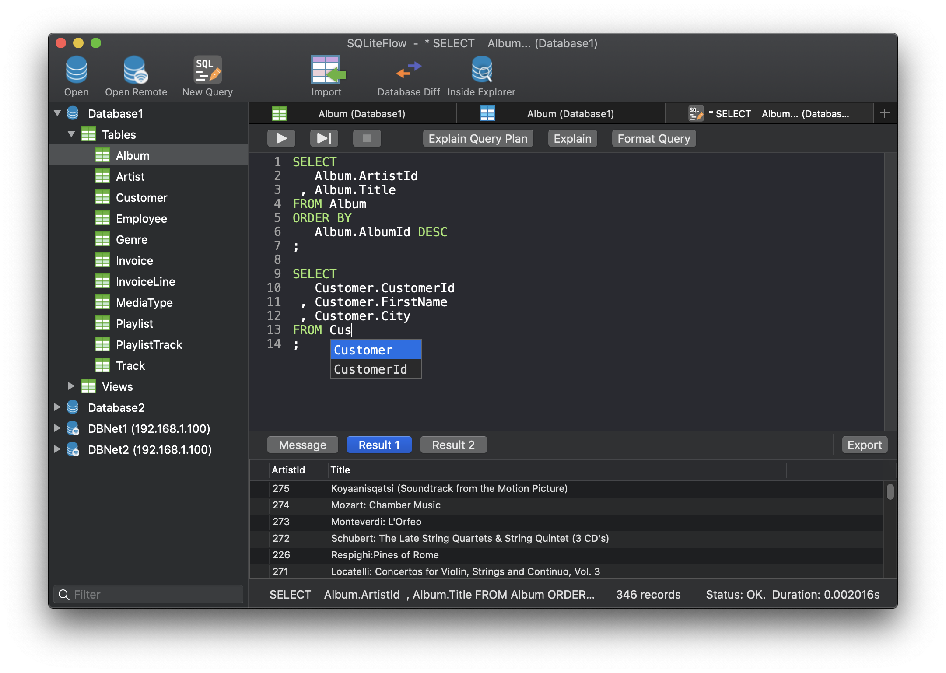
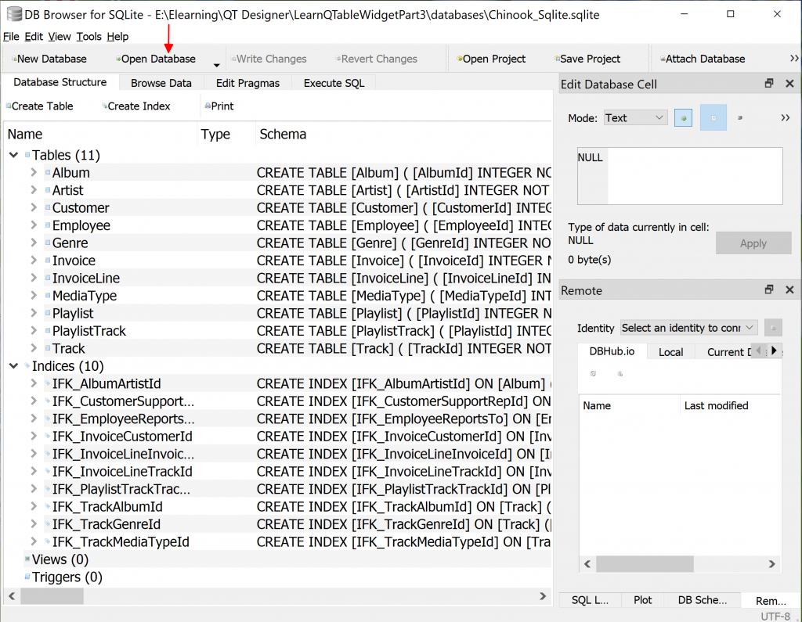
2. Create SQLite database
Using Tool: DB Browser, SQLite Studio, SQLiteFlow,
Coding directly creates database for the application

Slide 7
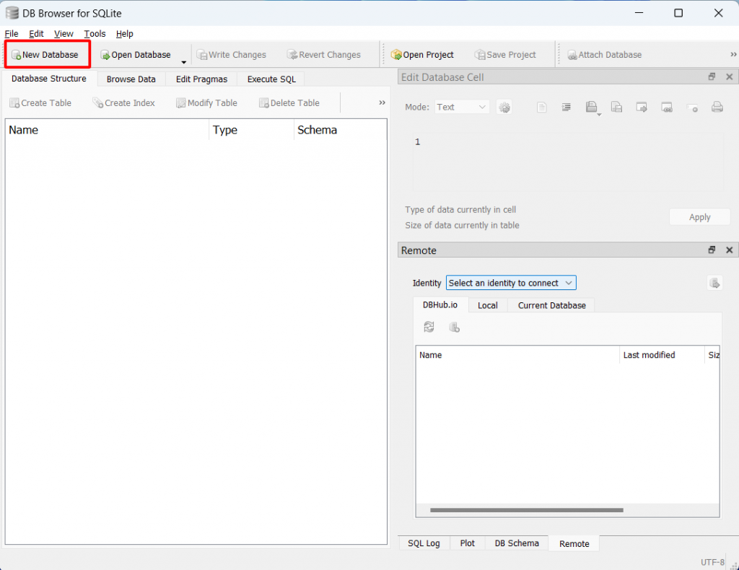
2. Create SQLite database
SQLite DB Browser:
https://sqlitebrowser.org/dl
https://tranduythanh.com/2024/01/04/bai-25-xu-ly-du-lieu-dang-bang-qtablewidget-va-sqlite-database-part-4/

Slide 8
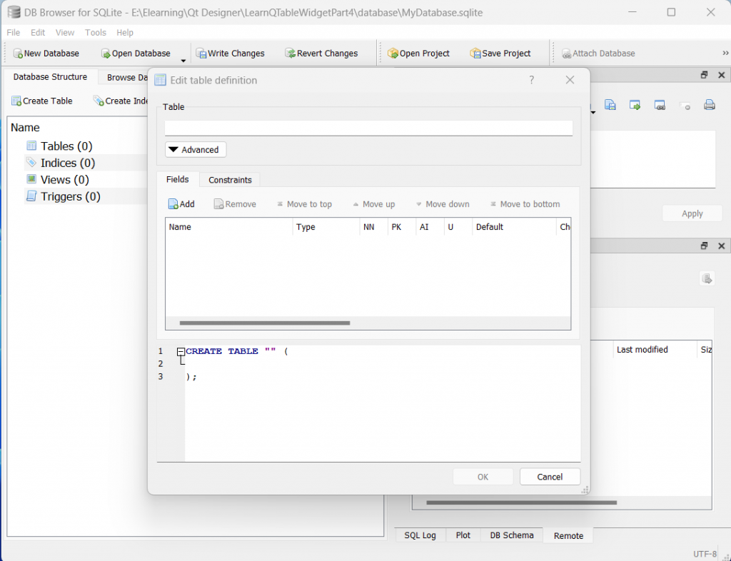
2. Create SQLite database

Slide 9
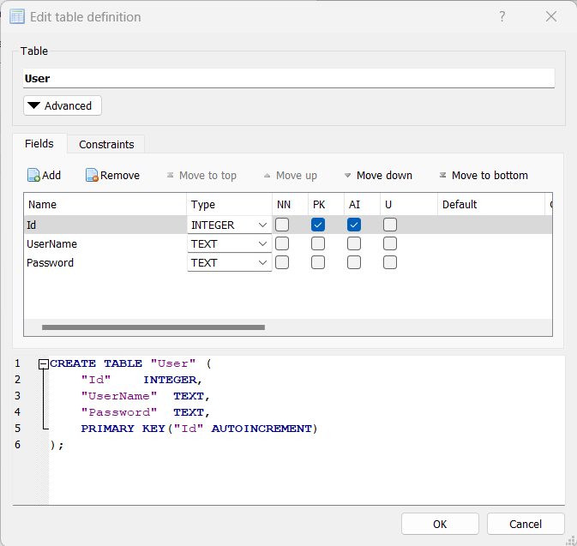
2. Create SQLite database

Slide 10
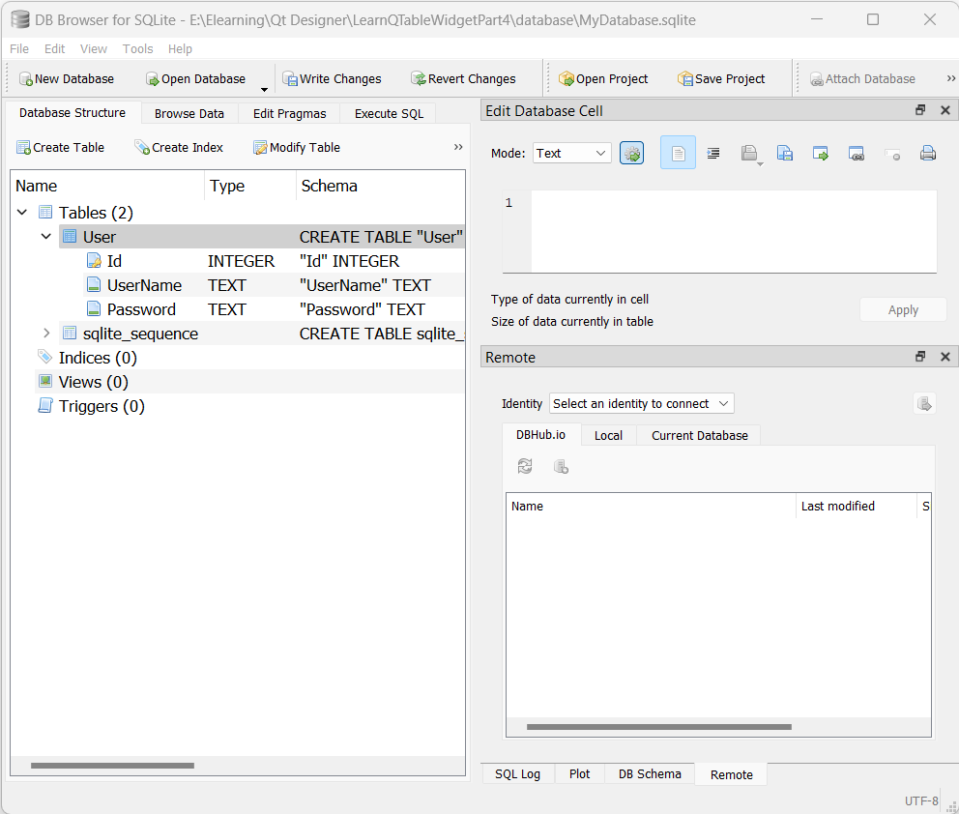
2. Create SQLite database

Slide 11
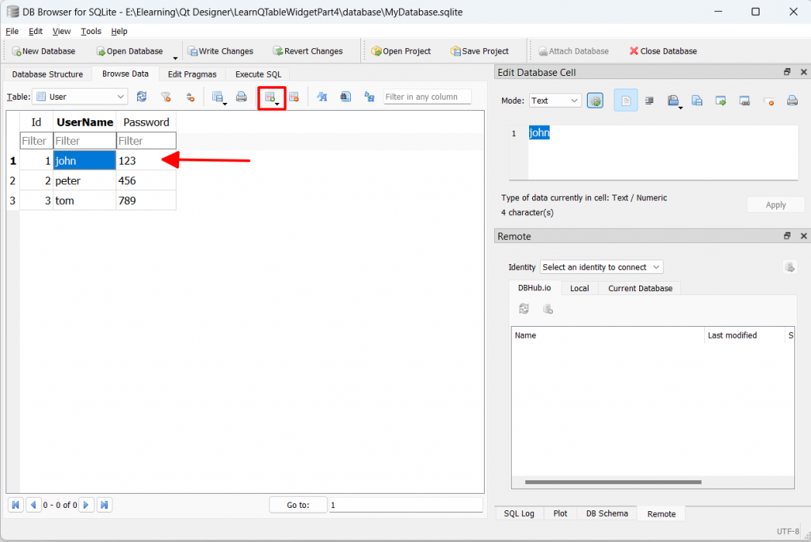
2. Create SQLite database

Slide 12
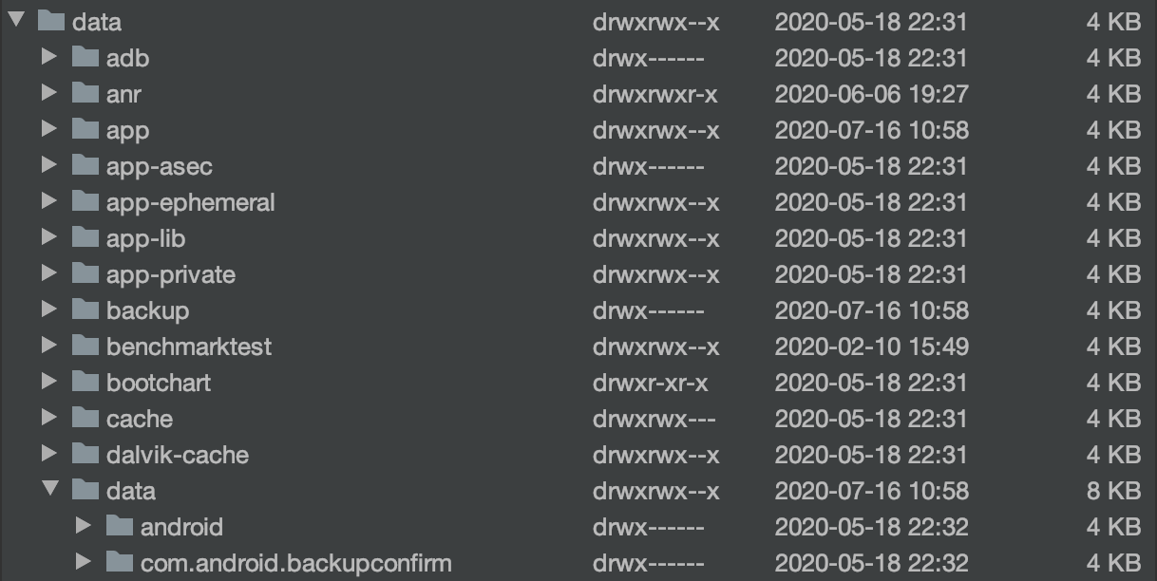
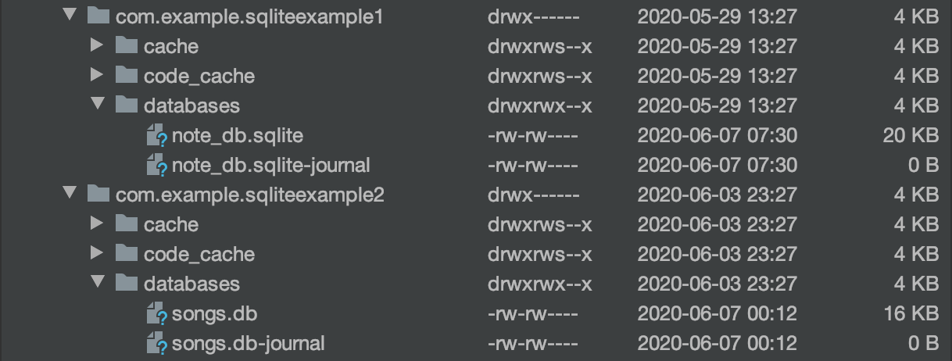
2. Create SQLite database

Slide 13
2. Create SQLite database
Coding copy SQLite database into device
public static final String DATABASE_NAME = "songs.db"; public static final String DB_PATH_SUFFIX = "/databases/"; public static SQLiteDatabase database = null;
private void copyDataBase(){ try{ File dbFile = getDatabasePath(DATABASE_NAME); if(!dbFile.exists()){ if(CopyDBFromAsset()){ Toast.makeText(MainActivity.this, "Copy database successful!", Toast.LENGTH_LONG).show(); }else{ Toast.makeText(MainActivity.this, "Copy database fail!", Toast.LENGTH_LONG).show(); } } }catch (Exception e){ Log.e("Error: ", e.toString()); } }

Slide 14
2. Create SQLite database
Coding copy SQLite database into device
private boolean CopyDBFromAsset() { String dbPath = getApplicationInfo().dataDir + DB_PATH_SUFFIX + DATABASE_NAME; try { InputStream inputStream = getAssets().open(DATABASE_NAME); File f = new File(getApplicationInfo().dataDir + DB_PATH_SUFFIX); if(!f.exists()){ f.mkdir(); } OutputStream outputStream = new FileOutputStream(dbPath); byte[] buffer = new byte[1024]; int length; while((length=inputStream.read(buffer))>0){ outputStream.write(buffer,0, length); } outputStream.flush(); outputStream.close(); inputStream.close(); return true; } catch (IOException e) { e.printStackTrace(); return false; } }

Slide 15
3. CRUD on SQLite database
Open SQLite Database
public static final String DATABASE_NAME = "songs.db"; public static final String TABLE_NAME = "song";
public static SQLiteDatabase database = null;
database = openOrCreateDatabase(DATABASE_NAME,
MODE_PRIVATE, null);

Slide 16
3. CRUD on SQLite database
Query with “rawQuery”
Cursor cursor = database.rawQuery("SELECT * FROM " + TABLE_NAME,
selectionArgs: null);
while(cursor.moveToNext()){ int id = cursor.getInt(0); int songCode = cursor.getInt(1); String songName = cursor.getString(2); String singer = cursor.getString(3); int favourite = cursor.getInt(4); //To do something …. }
cursor.close();

Slide 17
3. CRUD on SQLite database
Query with “rawQuery”
Cursor cursor = database.rawQuery( "SELECT * FROM " + TABLE_NAME + " WHERE Favourite = ? AND
(SongCode LIKE ? OR SongName LIKE ? OR Singer LIKE ?)", new String[]{"1", "%" + s + "%", "%" + s + "%", "%" + s + "%"});
while(cursor.moveToNext()){ int id = cursor.getInt(0); int songCode = cursor.getInt(1); String songName = cursor.getString(2); //To do something …. }
cursor.close();

Slide 18
3. CRUD on SQLite database
Product SQLite database: Query
Cursor cursor = database.query("Product", columns: null,
selection: null, selectionArgs: null, groupBy: null, having: null, orderBy: null);
Cursor cursor = database.rawQuery( "SELECT * FROM Product WHERE ProductId = ? OR ProductId = ?", new String[] {"2", "3"});
Cursor cursor = database.query("Product", columns: null,
selection: “ProductId = ? OR ProductId = ?”,
selectionArgs: new String[] {"2", "3"}, groupBy: null, having: null, orderBy: null);

Slide 19
3. CRUD on SQLite database
Product SQLite database: Insert
ContentValues values = new ContentValues(); values.put("ProductName", pName); values.put("ProductPrice", pPrice); long flag = database.insert("Product", nullColumnHack: null, values); if(flag > 0) Toast.makeText(AddProductActivity.this, "Add product successful!", Toast.LENGTH_LONG).show(); else Toast.makeText(AddProductActivity.this, "Add product fail!", Toast.LENGTH_LONG).show();

Slide 20
3. CRUD on SQLite database
Product SQLite database: Insert
databases.QueryData("INSERT INTO Product VALUES(
null, ‘Laptop Dell XPS’, 26500000)");

Slide 21
3. CRUD on SQLite database
Product SQLite database: Delete
int flag = database.delete("Product", "ProductId=?", new String[]{“1”}); if(flag > 0) //Delete successful else //Delete failed
//Delete data databases.QueryData("DELETE FROM Product WHERE ProductId = 1");

Slide 22
3. CRUD on SQLite database
Product SQLite database: Update
ContentValues values = new ContentValues(); values.put("ProductName", "new name"); int flag = database.update("Product", values, "Id=?", new String[]{“1”}); if(flag > 0) //update successful else // update failed
//Update data databases.QueryData("UPDATE Product SET ProductName = 'new name' WHERE ProductId = 1");

Slide 23
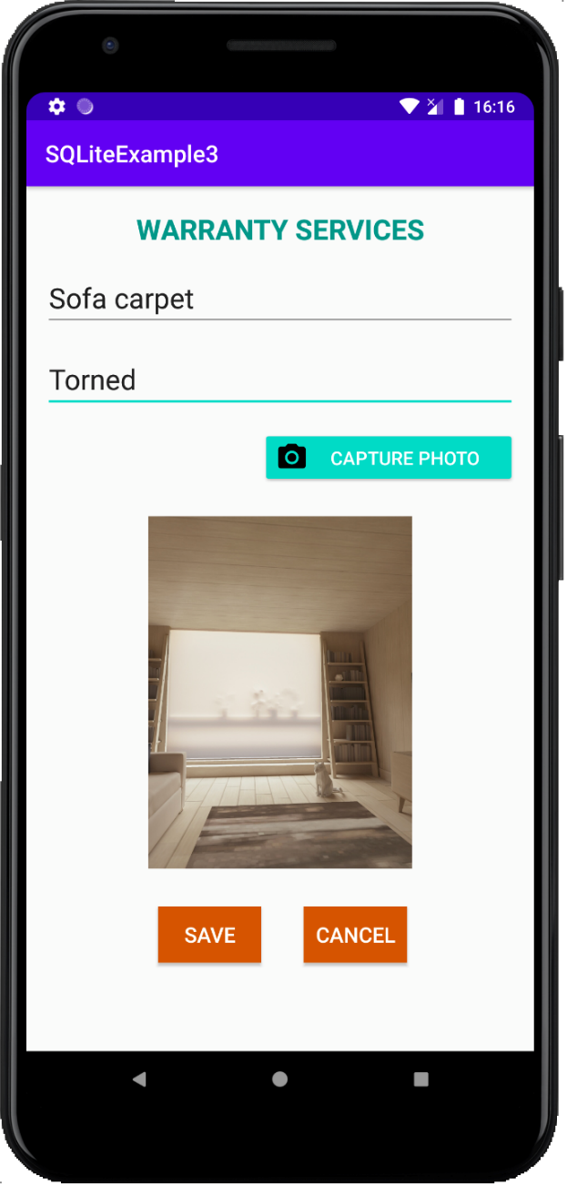
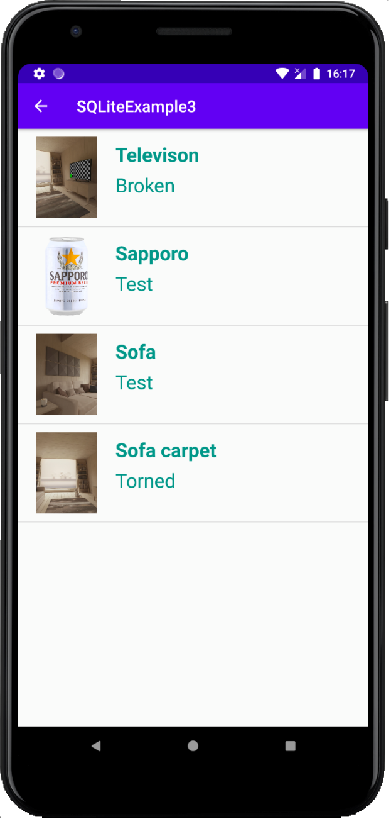
4. Working with image data

Slide 24
4. Working with image data
public void insertData(String name, String des, byte[] photo){ SQLiteDatabase database = getWritableDatabase(); String sql = "INSERT INTO Product VALUES(null, ?, ?, ?)";
SQLiteStatement statement = database.compileStatement(sql); statement.clearBindings(); statement.bindString(1, name); statement.bindString(2, des); statement.bindBlob(3, photo);
statement.executeInsert(); }

Slide 25
4. Working with image data
private byte[] convertPhoto() { BitmapDrawable drawable = (BitmapDrawable) imgPhoto.getDrawable(); Bitmap bitmap = drawable.getBitmap(); ByteArrayOutputStream outputStream = new ByteArrayOutputStream(); bitmap.compress(Bitmap.CompressFormat.PNG, 100, outputStream); return outputStream.toByteArray(); }
database.insertData(“Sofa carpet”, “Torned”, convertPhoto());

Slide 26
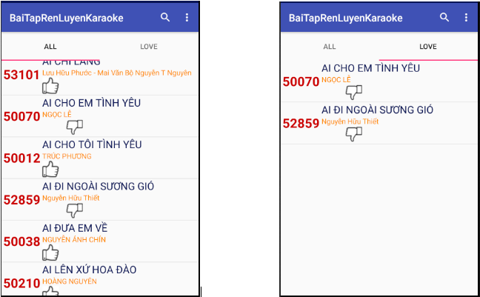
Exercise
https://www.mediafire.com/file/8pd05w41bs2bbpl/databases.rar/file
Arirang.sqlite database

Slide 27
Discussions
Q1: Present SQLite database
Q2: Present using DB Browser
Q3: How to copy SQLite database into Device?
Q4: Present CRUD algorithms for SQLite database
Q5: How to work with image data in SQLite database?

Slide 28
Next Lesson
Content Provider

Slide 29
THANK YOU!

